Slide 1
Data Mining
Set of techniques to gain insights from (typically large) data sets
Can be either descriptive or predictive:
Unsupervised learning
Supervised learning

Slide 2
Unsupervised Learning
Detect patterns and relationships
Not trying to predict any particular “outcome”
k-means clustering
Hierarchical clustering
Association rules

Slide 3
Clustering
To cluster a data set means to split the data up into groups (clusters).
Points in a cluster should be:
Similar to each other
Dissimilar to points in other clusters.
The goal is not to “create” clusters; it’s to identify the existing clusters in the data!

Slide 4
Clustering Illustration

Slide 5
Measure of Distance
Before we get into specific methods, we need to be able to answer a hard question about our data:
How close are two data points to one another?
We need to be able to measure how similar (or dissimilar) two points are.

Slide 6
Measure of Distance
40
($18,000, 35)
($25,000, 35)
Which car is more similar to the blue car? Why?
30
MPG
20
($20,000, 15)
10
10,000
20,000
30,000
MSRP ($)

Slide 7
Euclidean Distance
When variables are quantitative:
The distance between point a and point b:
(Treats a and b as physical points in space, and calculates how far apart they are)
Problem: heavily influenced by scales

Slide 8
Normalizing Distances
Need to convert variables to comparable scales
Most common approach is z-scores
Puts them on the same scale; the larger-unit scales won’t drown out the smaller-unit scales
Can do in either Excel or R (scale function)
Most software will not do this automatically!

Slide 9
k-Means Clustering
Goal is to split data into k clusters, and create k prototype data points
How software does it:
Assign data points randomly to clusters
Compute centroid of each cluster
Reassign data points to cluster whose centroid is closest
Repeat steps two and three until no data points change clusters (or until some given accuracy level is reached)

Slide 10
k-Means Clustering

Slide 11
How to Choose k
Sometimes determined by context, e.g.:
The manufacturing plant has five assembly lines
We can choose three advertising packages
Otherwise, it is subjective!

Slide 12
How Good Are the Results?
Many different metrics out there
They’re all trying to find a value of k where:
Points in the same cluster are similar to each other
Points in one cluster are dissimilar to points in other clusters

Slide 13
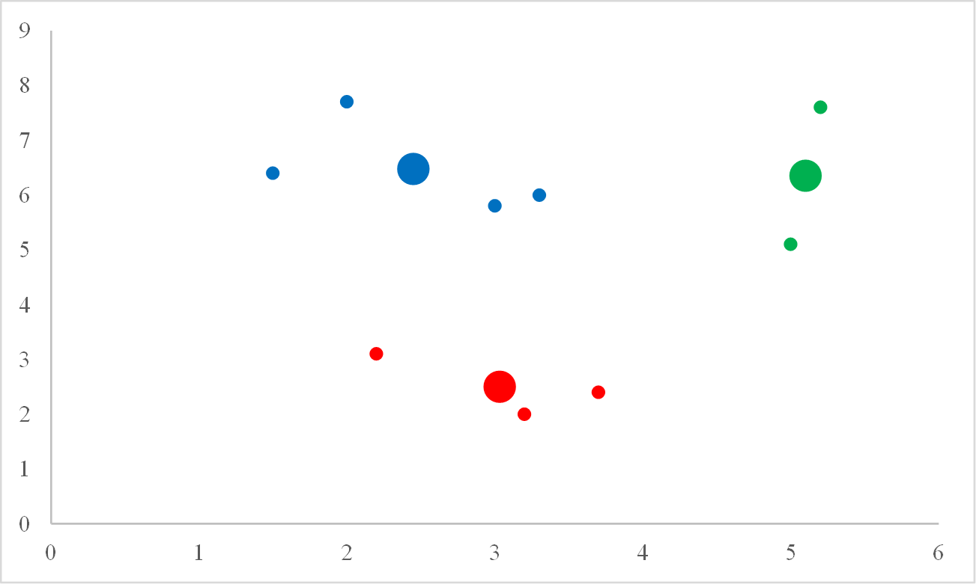
Cluster Visualization
Create a scatterplot of points color coded by cluster
Easier to understand than a centroid table
But what if we have more than two variables?
Solution: principal component analysis

Slide 14
Principal Component Analysis
A method for reducing the number of variables by taking advantage of correlations
Rotate the axes but not the data:
dim₁
Now we have one very useful variable (dim₁), and one that we can probably ignore (dim₂).
x₂
PCA does this with all the variables at once.
dim₂
x₁

Slide 15
Principal Component Analysis
Example: in the mtcars dataset, cyl, mpg, disp, hp, and wt are all strongly correlated
A single dimension can mostly capture all of them at once
Many uses for PCA, here we’ll plot the clusters in the two most useful dimensions (the two that capture the most variability in the data)

